Slide 1
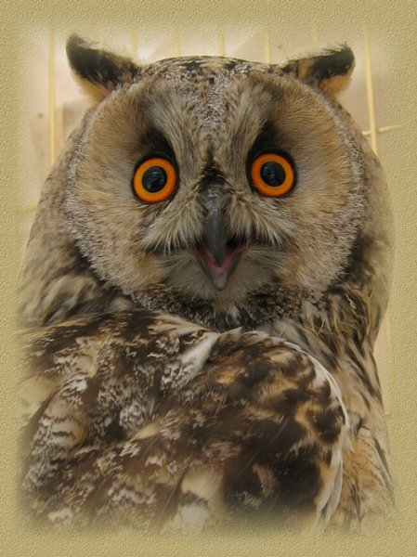
What? Where? When?
ШКОЛА ПРИ ПОСОЛЬСТВЕ РОССИИ В ИЗРАИЛЕ
Презентацию подготовила: учитель английского языка Свищёва А.М.
Тель-Авив
2015

Slide 2
ШКОЛА ПРИ ПОСОЛЬСТВЕ РОССИИ В ИЗРАИЛЕ
Thousands of tourists come to a famous place in Britain
to see somebody that has never been seen and to visit
the museum devoted to that never seen somebody.
What is the place and who is that mysterious somebody?

Slide 3
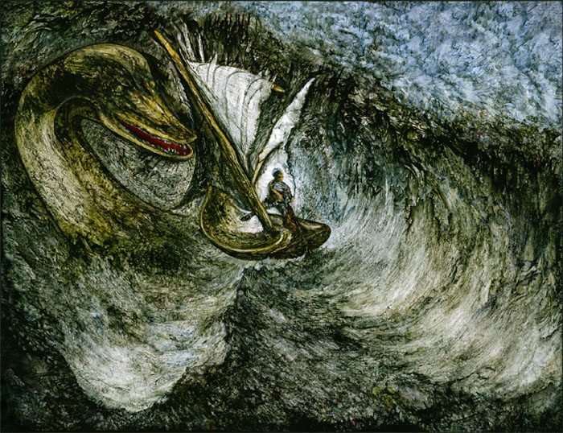
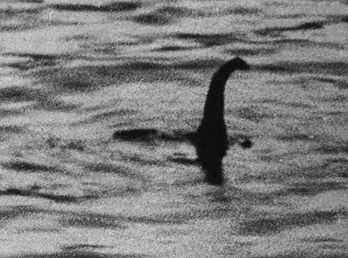
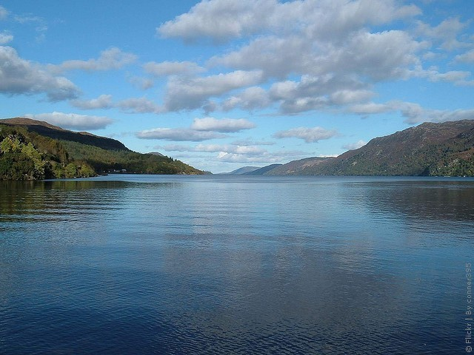
ШКОЛА ПРИ ПОСОЛЬСТВЕ РОССИИ В ИЗРАИЛЕ
Lake Loch Ness and Loch Ness monster.

Slide 4
ШКОЛА ПРИ ПОСОЛЬСТВЕ РОССИИ В ИЗРАИЛЕ
Attention! Look at these French words:
pot – горшок, nez –нос, velur – мягкий, garder – хранить, cheveux – волосы, cacher – прятать,
robe – платье, pencer –защемлять.
Having joined in pairs these words came
to the Russian language.
Find these words in our native language.

Slide 5
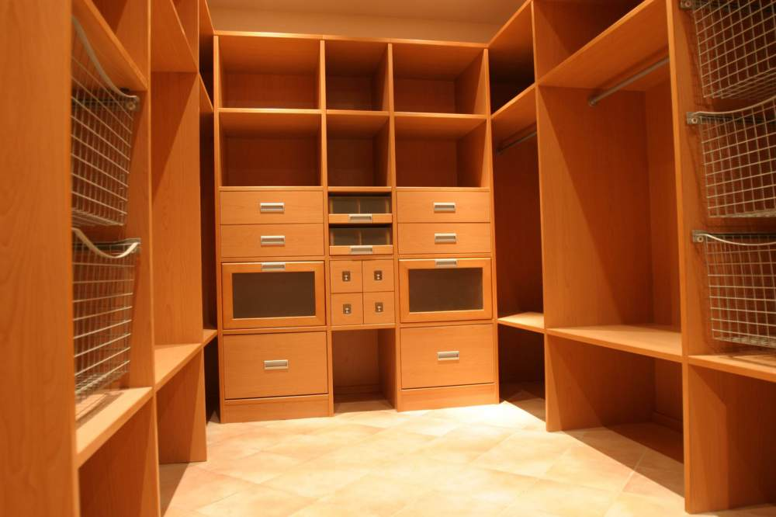
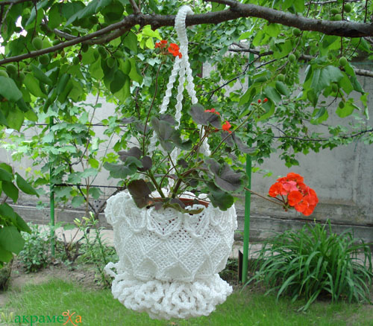
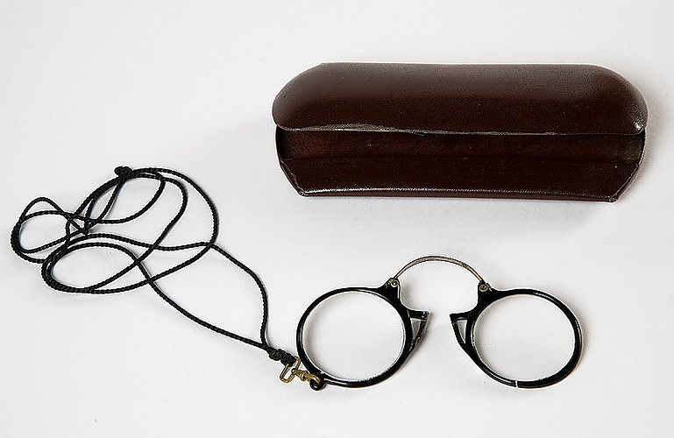
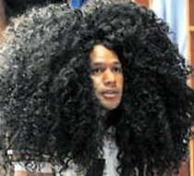
ШКОЛА ПРИ ПОСОЛЬСТВЕ РОССИИ В ИЗРАИЛЕ
Гардероб
кашпо
пенсне
шевелюра

Slide 6
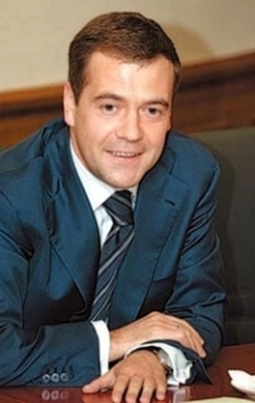
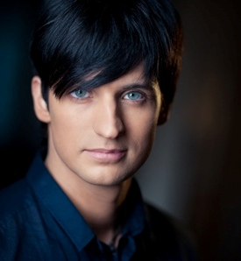
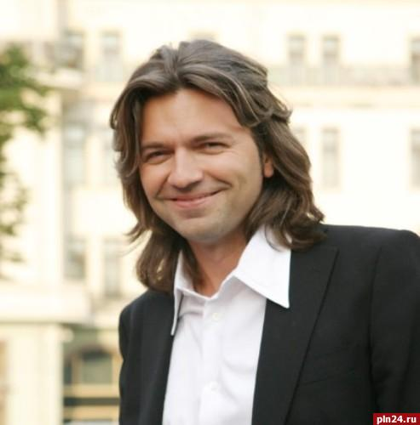
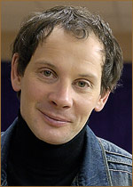
ШКОЛА ПРИ ПОСОЛЬСТВЕ РОССИИ В ИЗРАИЛЕ
Look at the screen! On the screen
there are 5 portraits.
Which portrait does not suit the group?

Slide 7
ШКОЛА ПРИ ПОСОЛЬСТВЕ РОССИИ В ИЗРАИЛЕ
Daniil Spivakovski
All the others are Dmitris

Slide 8
ШКОЛА ПРИ ПОСОЛЬСТВЕ РОССИИ В ИЗРАИЛЕ
“Mona Lisa” is a well-known picture of Leonardo da Vinci. Giaconda doesn’t have one detail in her appearance, though every person has it.
What is it?

Slide 9
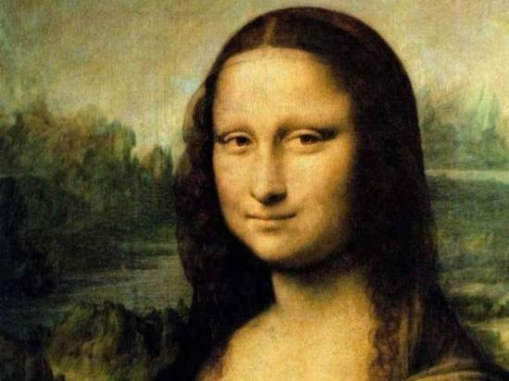
ШКОЛА ПРИ ПОСОЛЬСТВЕ РОССИИ В ИЗРАИЛЕ
Eyebrows

Slide 10
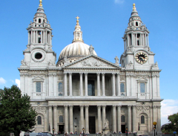
ШКОЛА ПРИ ПОСОЛЬСТВЕ РОССИИ В ИЗРАИЛЕ
St Paul's Cathedral is one of the most
famous buildings in the world.
There was once a Roman temple.
Since then there have been four different
Christian buildings. The first Christian church
being made of wood was eventually
burnt down. It was rebuilt in stone but was
destroyed in a Viking invasion. The third church,
was destroyed by fire again!
Who was the cathedral's final architect.

Slide 11
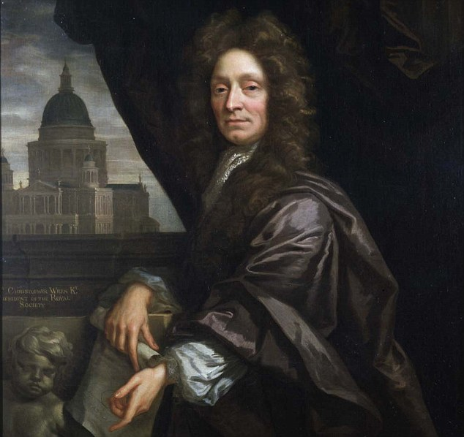
ШКОЛА ПРИ ПОСОЛЬСТВЕ РОССИИ В ИЗРАИЛЕ
Sir Christopher Wren

Slide 12
ШКОЛА ПРИ ПОСОЛЬСТВЕ РОССИИ В ИЗРАИЛЕ
An African tribe Suahili has a legend about the first man who walks down the sky on earth.
What creature helped him to do it?

Slide 13
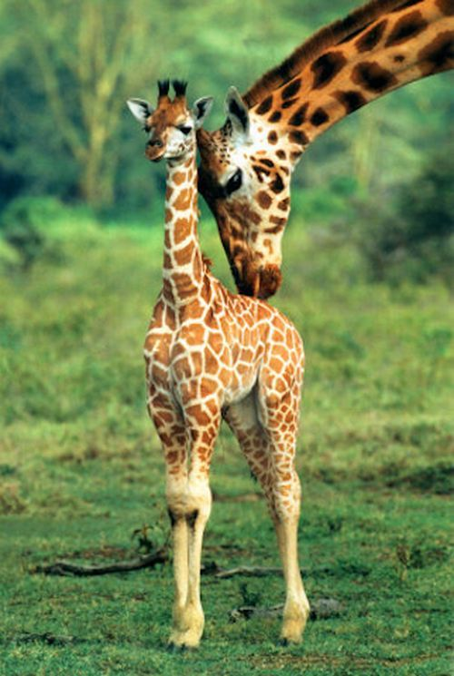
ШКОЛА ПРИ ПОСОЛЬСТВЕ РОССИИ В ИЗРАИЛЕ
A giraffe
A giraffe

Slide 14
ШКОЛА ПРИ ПОСОЛЬСТВЕ РОССИИ В ИЗРАИЛЕ
The English say that even after a long practice they can’t pronounce this Russian phrase in a right way. At the best in result they have something that can be translated in Russian as “жёлто-голубой автобус”.
What is this phrase?

Slide 15
ШКОЛА ПРИ ПОСОЛЬСТВЕ РОССИИ В ИЗРАИЛЕ
I love you (Я люблю Вас).

Slide 16
ШКОЛА ПРИ ПОСОЛЬСТВЕ РОССИИ В ИЗРАИЛЕ
French playwright D’Ecurcel thought that it was the mean(средство) for the rich and the aim for the poor. Alexandre Dumas (son) was sure that it was a good servant and a bad master. Belinsky called it “the sun of life and without it life is difficult dark and cold”.
What is it?

Slide 17
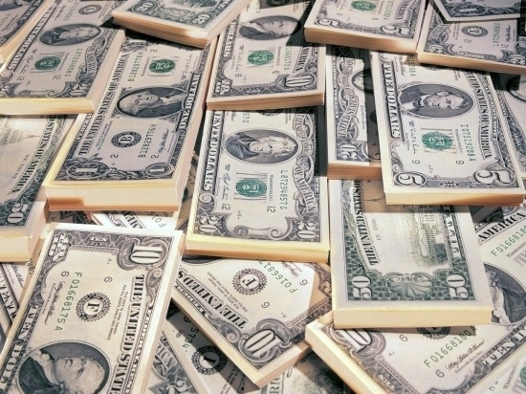
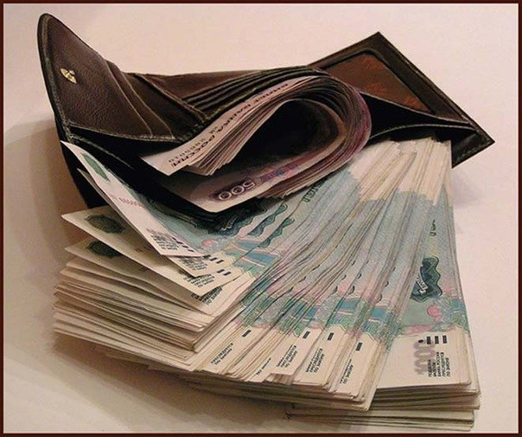
ШКОЛА ПРИ ПОСОЛЬСТВЕ РОССИИ В ИЗРАИЛЕ
Money

Slide 18
ШКОЛА ПРИ ПОСОЛЬСТВЕ РОССИИ В ИЗРАИЛЕ
If you got lost in the forest, you would always have an opportunity to define where the North is (moss always grows on the north side of a tree). But even if you went under the hot sun of the Kara-Kum desert where you couldn't find a tree, you would always see the thing that would show you the North.
What is it?

Slide 19
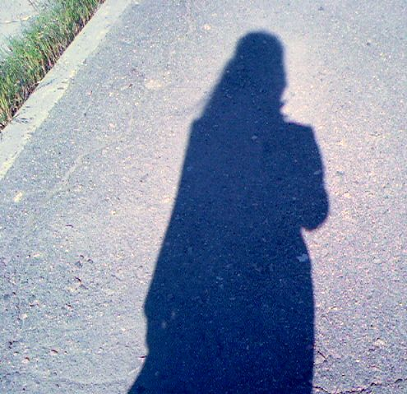
ШКОЛА ПРИ ПОСОЛЬСТВЕ РОССИИ В ИЗРАИЛЕ
_______
It is your shadow.

Slide 20
ШКОЛА ПРИ ПОСОЛЬСТВЕ РОССИИ В ИЗРАИЛЕ
John Osborn (a famous playwright) insisted that we couldn’t believe newspapers and it. A group of Swedish philologists decided to find out who used it more often: men or women. They placed it in one of Stockholm’s department store. During one day it was used by 412 women and 778 men.
What is it?

Slide 21
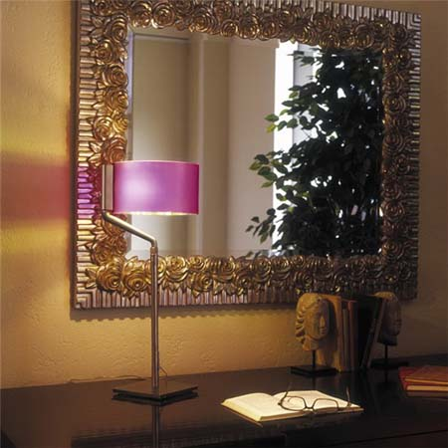
ШКОЛА ПРИ ПОСОЛЬСТВЕ РОССИИ В ИЗРАИЛЕ
A mirror

Slide 22
ШКОЛА ПРИ ПОСОЛЬСТВЕ РОССИИ В ИЗРАИЛЕ
This famous scientist served two terms in the British Parliament. During the two years he spent in the House of Commons, he never opened his mouth except once, when he asked someone in the gallery to open a window.
Who was this scientist?

Slide 23
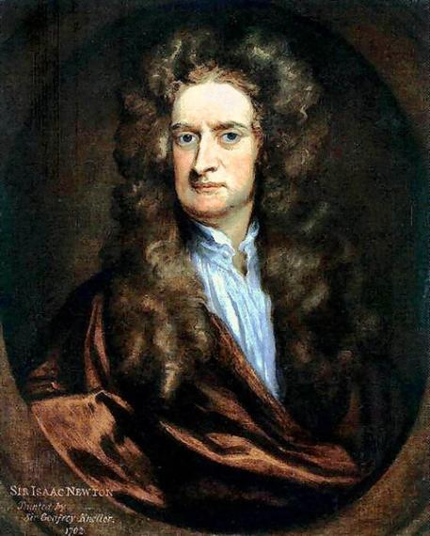
ШКОЛА ПРИ ПОСОЛЬСТВЕ РОССИИ В ИЗРАИЛЕ
Isaac Newton

Slide 24
ШКОЛА ПРИ ПОСОЛЬСТВЕ РОССИИ В ИЗРАИЛЕ
The real name of this actor, film director and composer was Charles Spencer. He became one of the best known film stars in the world before the end of the First World War.
He was …

Slide 25
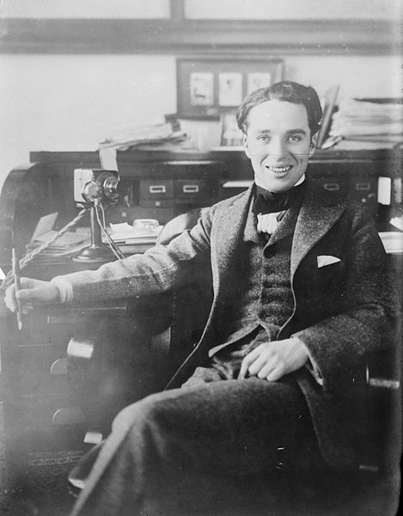
Charlie Chaplin

Slide 26
This celebration is held of the 25th of January, the anniversary of the birth Scotland’s greatest national poet. It usually takes the form of a supper at which traditional Scottish dishes are eaten.
What is his name?

Slide 27
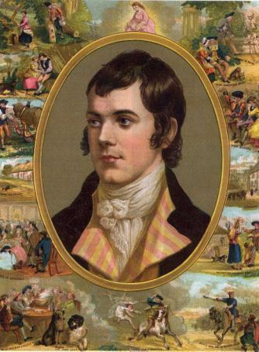
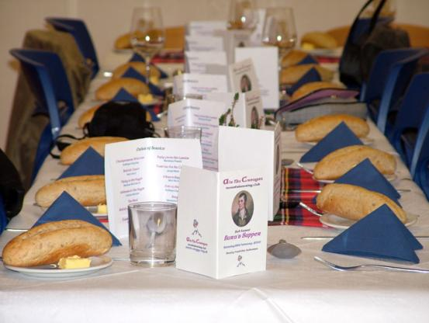
Burn’s Supper

Slide 28
ШКОЛА ПРИ ПОСОЛЬСТВЕ РОССИИ В ИЗРАИЛЕ
The end of the game. We hope you’ve enjoyed it.

